Slide 1
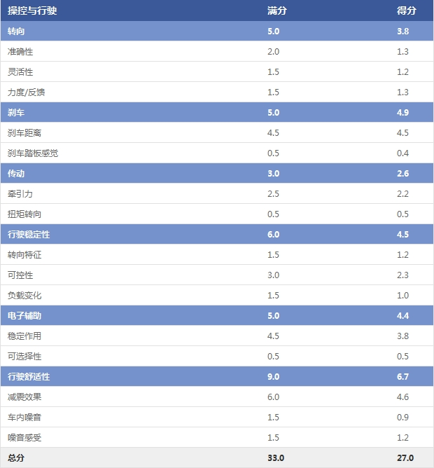
操控与行驶 | 满分 | 得分
转向 | 5.0 | 3.8
准确性 | 2.0 | 1.3
灵活性 | 1.5 | 1.2
力度/反馈 | 1.5 | 1.3
刹车 | 5.0 | 4..9
刹车距离 | 4.5 | 4.5
刹车踏板感觉 | 0.5 | 0.4
传动 | 3.0 | 2.6
牵引力 | 2.5 | 2.2
扭矩转向 | 0.5 | 0.5
行驶稳定性 | 6.0 | 4.5
转向特征 | 1.5 | 1.2
可控性 | 3.0 | 2.3
负载变化 | 1.5 | 1.0
电子辅助 | 5.0 | 4.4
稳定作用 | 4.5 | 3.8
可选择性 | 0.5 | 0.5
行驶舒适性 | 9.0 | 6.7
减震效果 | 6.0 | 4.6
车内噪音 | 1.5 | 0.9
噪音感受 | 1.5 | 1.2
总分 | 33.0 | 27.0
Operation | Full marks | Score
Steering | 5.0 | 3.8
Accuracy | 2.0 | 1.3
Flexibility | 1.5 | 1.2
Intensity/Feedback | 1.5 | 1.3
Brake | 5.0 | 4..9
Brake distance | 4.5 | 4.5
Brake pedal feel | 0.5 | 0.4
Transmission | 3.0 | 2.6
Traction | 2.5 | 2.2
Torque steering | 0.5 | 0.5
Driving stability | 6.0 | 4.5
Turning | 1.5 | 1.2
Handle | 3.0 | 2.3
Load change | 1.5 | 1.0
Electronic assistance | 5.0 | 4.4
Steady | 4.5 | 3.8
Optional | 0.5 | 0.5
Comfort | 9.0 | 6.7
Shock absorption | 6.0 | 4.6
Interior noise | 1.5 | 0.9
Noise feeling | 1.5 | 1.2
Total | 33.0 | 27.0

Slide 2
